Slide 1
Design and Implementation of a Feedback System for One-Legged Series Elastic Actuated (SEA) Robot
Presented by:
Ahmed Khaled Mady
Supervised by:
Dr. Eng. Omar M. Shehata
Eng. Andrew M. Faried

Slide 2
Outline
Motivation
Introduction
Problem Statement
The State of Art
Thesis Objective
Methodology
Results and Discussion
Conclusion
Future Recommendations
References

Slide 3
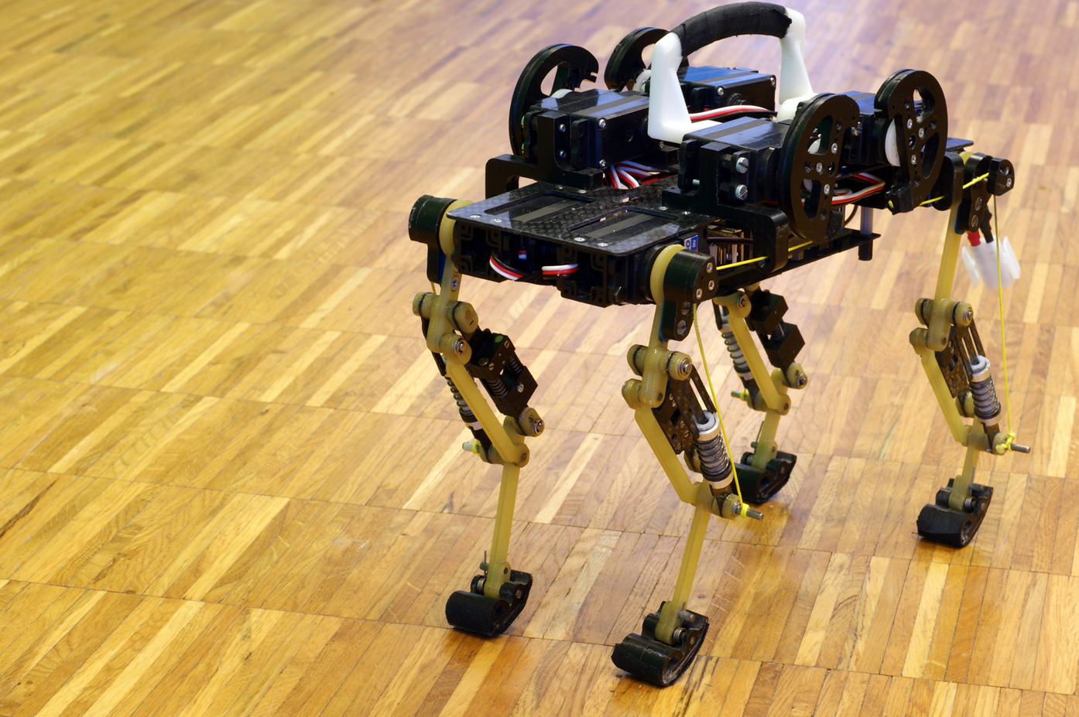
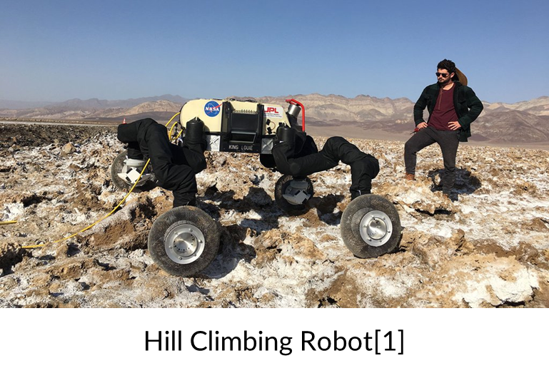
Motivation
Motivation
Introduction
Problem Statement
The State of Art
Thesis Objective
Methodology
Results and Discussion
Conclusion
Future Recommendations
References
Rigid Robot [2]

Slide 4

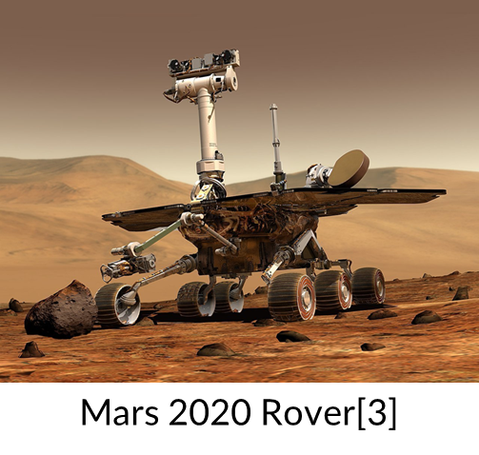
Robotics
A robot is a programmable machine that can assist people or emulate human actions. Robots have evolved to accomplish duties such as fighting fires and aiding with extremely complex procedures. Each robot has a different degree of autonomy, ranging from fully autonomous to human-controlled.
Robotics Features
All robots have some type of mechanical structure.
Electrical components are required by robots to manage and power the machines.
At least some amount of computer programming is present in robots.
Motivation
Introduction
Problem Statement
The State of Art
Thesis Objective
Methodology
Results and Discussion
Conclusion
Future Recommendations
References
RBX1 Robot [4]

Slide 5
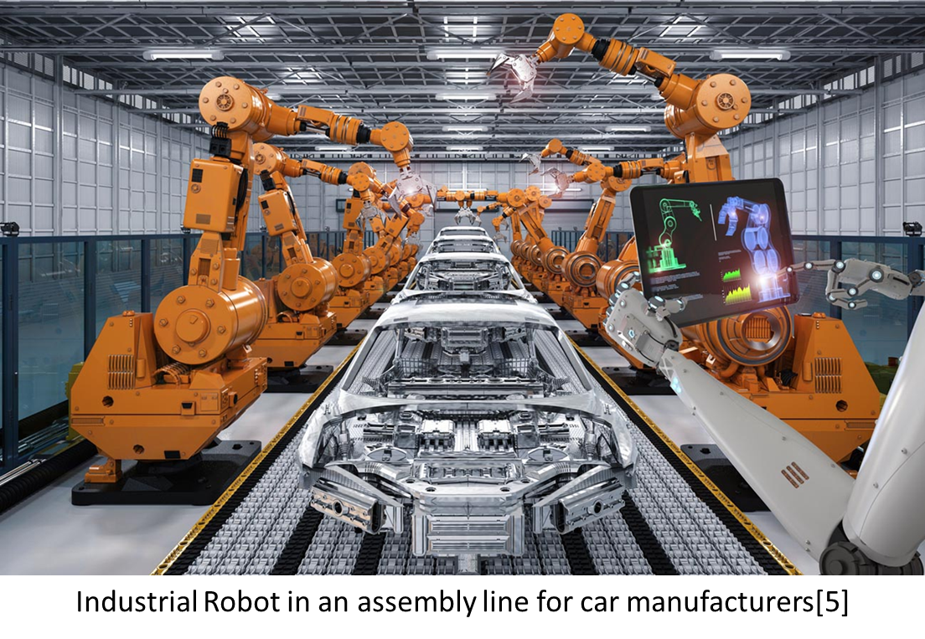
Industrial Robots
Motivation
Introduction
Problem Statement
The State of Art
Thesis Objective
Methodology
Results and Discussion
Conclusion
Future Recommendations
References
An industrial robot is a versatile, automatically controlled, re-programmable manipulator with three or more axes that can be fixed or mobile for industrial automation applications. Industrial robots are used as material handling devices (moving work components between machines) or in additive or subtractive production processes.

Slide 6
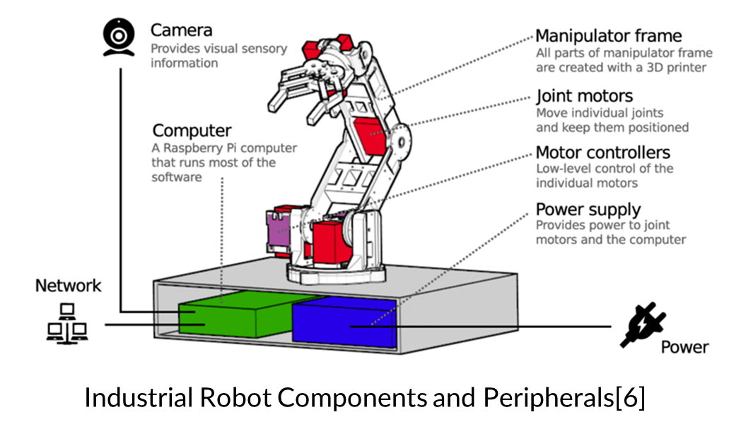
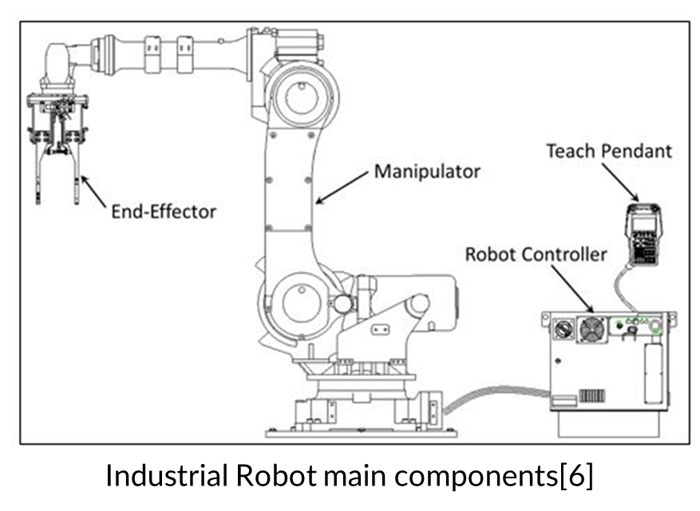
Industrial Robot Components
Motivation
Introduction
Problem Statement
The State of Art
Thesis Objective
Methodology
Results and Discussion
Conclusion
Future Recommendations
References

Slide 7
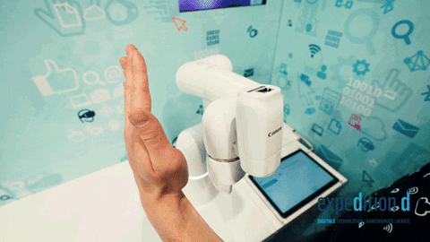
CoBots
Motivation
Introduction
Problem Statement
The State of Art
Thesis Objective
Methodology
Results and Discussion
Conclusion
Future Recommendations
References
A cobot, or collaborative robot, is a robot intended for direct human-robot interaction within a shared space, or where humans and robots are in close proximity. Cobot applications contrast with traditional industrial robot applications in which robots are isolated from human contact.
A cobot’s safety is tested[7]

Slide 8
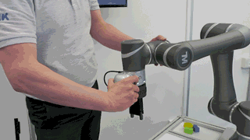
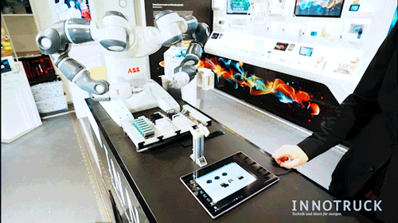
CoBots in Active Compliance
Motivation
Introduction
Problem Statement
The State of Art
Thesis Objective
Thesis Contributions
Methodology
Results and Discussion
Conclusion
Future Recommendations
References
Safety-rated monitored stop (SRMS)
Hand guiding (HG)
Speed and separation monitoring (SSM)
In power and force limiting (PFL)
Hand Guiding Cobots and Speed-Separation Monitoring Cobots[8]

Slide 9
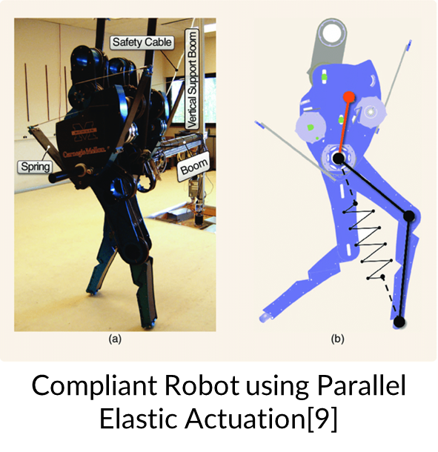
CoBots in Passive Compliance
Motivation
Introduction
Problem Statement
The State of Art
Thesis Objective
Thesis Contributions
Methodology
Results and Discussion
Conclusion
Future Recommendations
References
In a human, the hamstring muscles work together to extend the thigh and flex the knee. When walking on an incline, the hamstrings primarily work to extend the thigh on the leading leg as the back leg is moved to the front. In robots, muscles are similar to the compliant element in the system. The human leg can sense the incline or the irregularities and, therefore, compensate for the balance of the rest of the body motion. In robots, springs or elastic bands can be used for energy storage and, in turn, supply the necessary energy needed to balance the bipedal robot on different grounds whether irregular or normal.

Slide 10
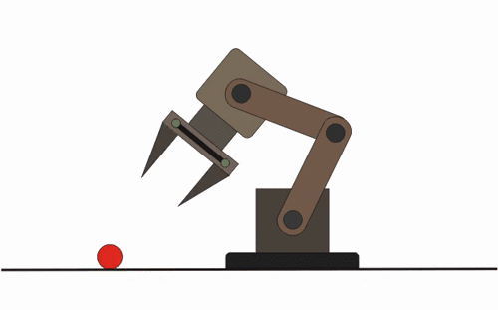
Rigid Actuators
Motivation
Introduction
Problem Statement
The State of Art
Thesis Objective
Thesis Contributions
Methodology
Results and Discussion
Conclusion
Future Recommendations
References
A stiff actuator is a mechanical device that can move to a precise location or follow a predetermined path. Whatever external pressures are applied to the actuator (within the device’s force limitations), once a position is attained, it will remain there.
Rigid Robot mechanism[10]

Slide 11
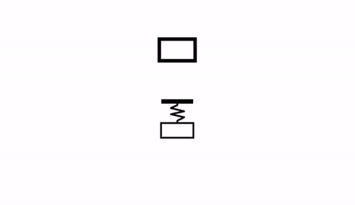
Compliant Actuators
Motivation
Introduction
Problem Statement
The State of Art
Thesis Objective
Thesis Contributions
Methodology
Results and Discussion
Conclusion
Future Recommendations
References
Depending on the supplied external force, a compliant actuator will tolerate departures from its own equilibrium position. A compliant actuator’s equilibrium position is defined as the point where the actuator creates zero force or torque.
Compliant Robot[10]

Slide 12
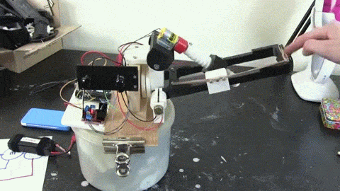
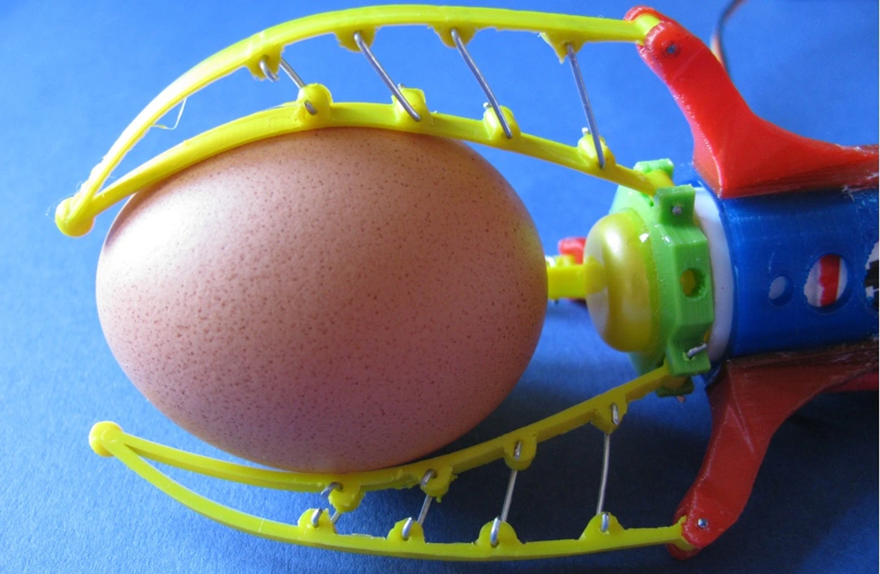
Problem Statement
Motivation
Introduction
Problem Statement
The State of Art
Thesis Objective
Methodology
Results and Discussion
Conclusion
Future Recommendations
References
Compliance
The term compliance refers to flexibility and agility. A compliant effector can reach several positions and exert different forces on a given object.
A compliant robot gripper can grasp an egg without crushing it with the proper settings. A non-compliant gripper will crush the egg and continue its given operation.
Back drivable Mechanism[12]
Egg gripper[11]

Slide 13
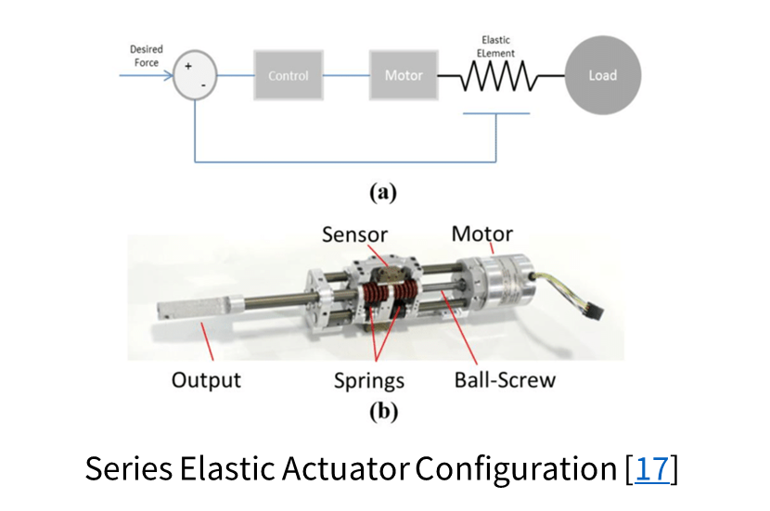
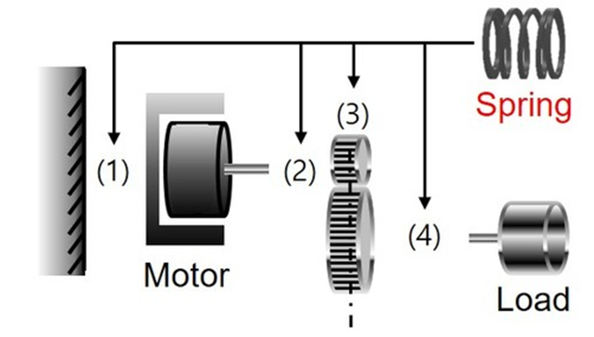
Series Elastic Actuator(SEA)
Motivation
Introduction
Problem Statement
The State of Art
Thesis Objective
Methodology
Results and Discussion
Conclusion
Future Recommendations
References
Unlike traditional actuation, which uses stiff gears to send force/torque to the load that is proportionate to the motor torque and current flowing through it, the torque transferred to the end load by a SEA is meant to be proportionate to the spring deformation, which is a major component of a SEA.
Reaction Force-Sensing Series Elastic Actuator (RFSEA)
Force-sensing Series Elastic Actuator (FSEA)
Transmitted Force-Sensing Series Elastic Actuator (TFSEA)

Slide 14
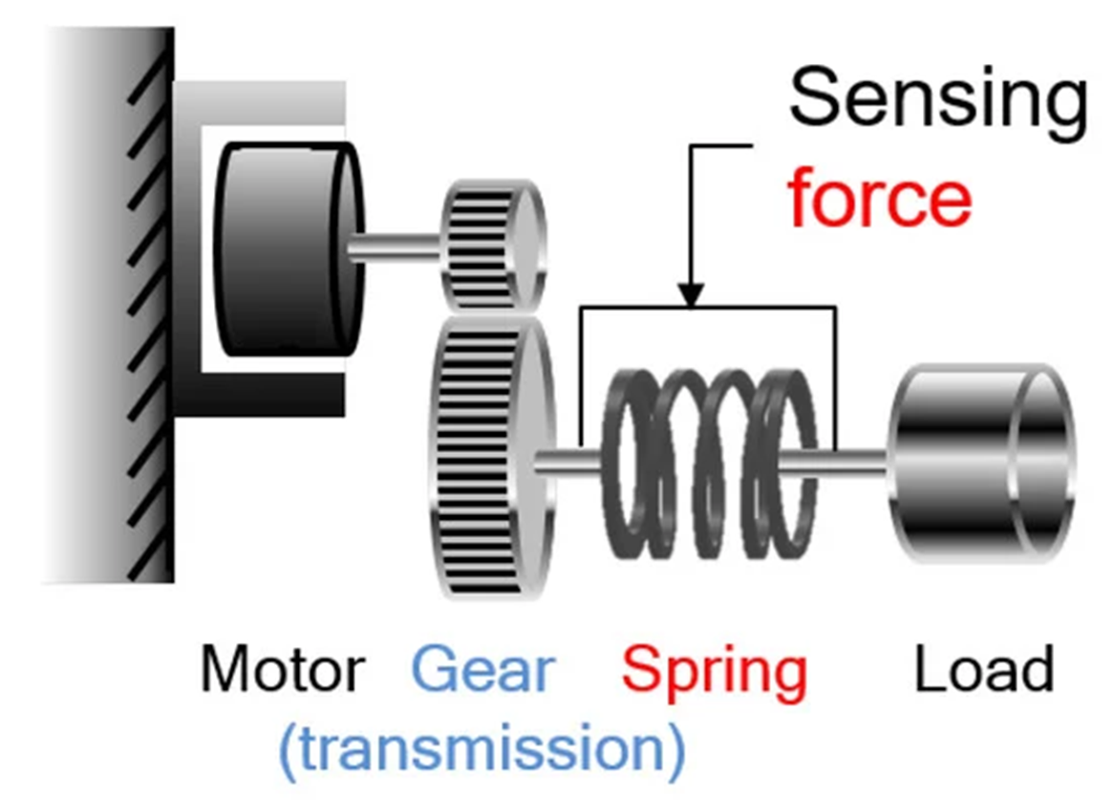
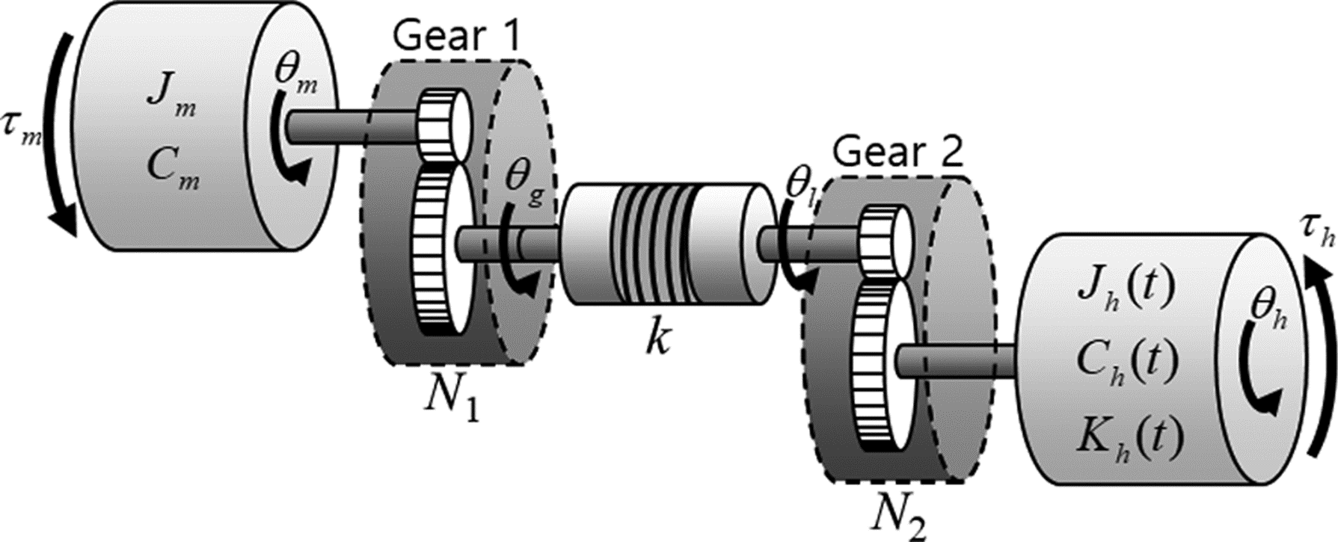
SEA Types
Motivation
Introduction
Problem Statement
The State of Art
Thesis Objective
Methodology
Results and Discussion
Conclusion
Future Recommendations
References
F-SEA TF-SEA
Series Elastic Actuator Configurations[12]

Slide 15
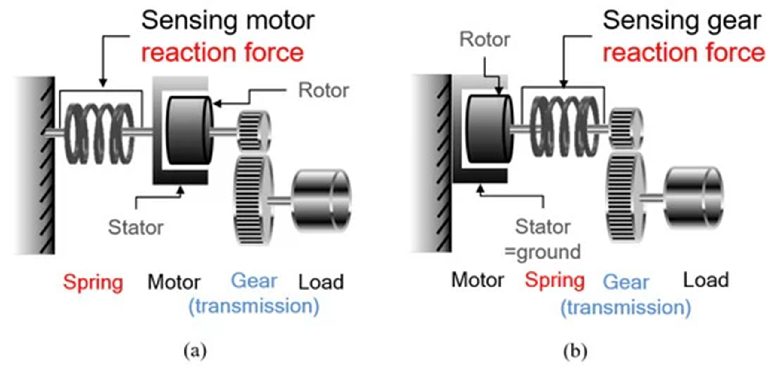
RF-SEA
Motivation
Introduction
Problem Statement
The State of Art
Thesis Objective
Methodology
Results and Discussion
Conclusion
Future Recommendations
References
Reaction Force Sensing Series Elastic Actuator[12]

Slide 16
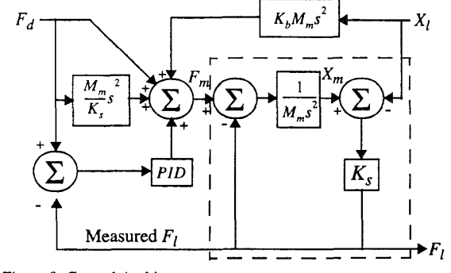
Various SEA Control Techniques
Motivation
Introduction
Problem Statement
The State of Art
⬤⭕⭕
Thesis Objective
Methodology
Results and Discussion
Conclusion
Future Recommendations
References
The feed-forward terms for the force applied through the elasticity to the load, the force required to accelerate the motor’s mass in order to change the deformation of the elasticity, and the force required to accelerate the motor’s mass so as to track the motion of the load.
Problem: In a real system the actuator will take on the natural impedance of the series elasticity at sufficiently high frequencies.
To avoid this problem, a minimum mass was placed on the load which lowers the resonant frequency to where the control loop operates well, at a low frequency where the impedance of the series elasticity disappears from the overall impedance (which is very low), and resonance cannot occur.
Control Loop designed by Pratt[13]

Slide 17
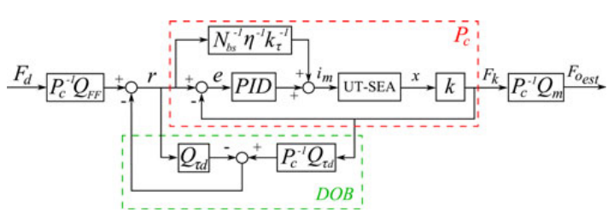
Various SEA Control Techniques
Motivation
Introduction
Problem Statement
The State of Art
⬤⬤⭕
Thesis Objective
Methodology
Results and Discussion
Conclusion
Future Recommendations
References
The goal of force control is to make the measured actuator output force (Fo) track the desired force profile (Fdes) using motor current (im) as the plant input and spring deflection (x) as the output.
The RF-SEA style actuator (Fo) cannot safely track (Fdes) for all frequencies. Instead, the force control approach regulates spring force (Fk). This sacrifices force tracking of (Fo) near resonant frequencies but guarantees safe and oscillation-free force tracking at all frequencies.
Force Control Loop by Paine [14]
To improve the force tracking performance further and to remove the steady-state error, a Disturbance Observer (DOB) was used. A DOB may be used to measure and compensate for errors from disturbances and reduce the effect of plant modeling error.

Slide 18
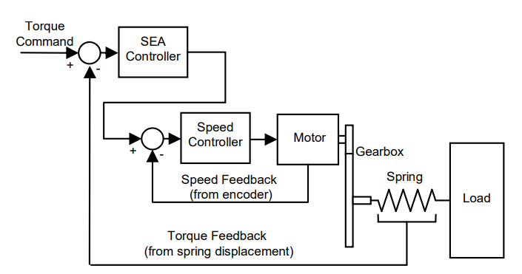
Various SEA Control Techniques
Motivation
Introduction
Problem Statement
The State of Art
⬤⬤⬤
Thesis Objective
Methodology
Results and Discussion
Conclusion
Future Recommendations
References
Brooks: Deflection in the beam, in which the spring was placed, was measured using strain gauges. The motor was controlled using current control as the input to the motor, making the motor an effective torque source. The compensation scheme used both feedback from the strain gauges, and feedforward from the desired torque input to calculate a desired current for the motor.
Problems: Backlash in the gearbox introduced some undesirable and unpredictable resonances in the closed-loop response, and friction effects limited the effectiveness of providing large force bandwidth.
In Robinson [8], the motor is to be controlled as a torque source. The effects of friction and backlash are better quantified, and some guidelines for spring selection is introduced.
Wyeth and Williamson’s treated the motor as a velocity source rather than as a torque source. Velocity is more straightforward from an implementation perspective, unlike current control which is generally considered challenging[15].

Slide 19
Thesis Objective
Motivation
Introduction
Problem Statement
The State of Art
Thesis Objective
Methodology
Results and Discussion
Conclusion
Future Recommendations
References
The Series Elastic Actuator (SEA), as a passive compliance actuator will be utilized to control the motion of a kangaroo and cheetah robotic legs in order to provide a feedback system to compare the efficiency and stability of each.

Slide 20
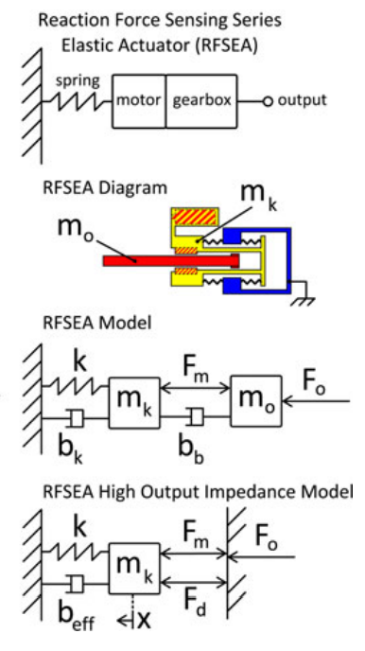

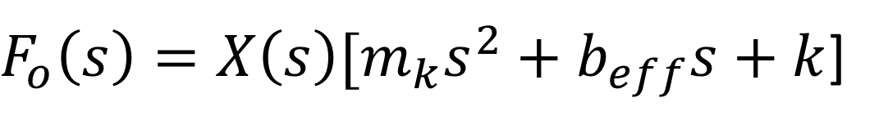
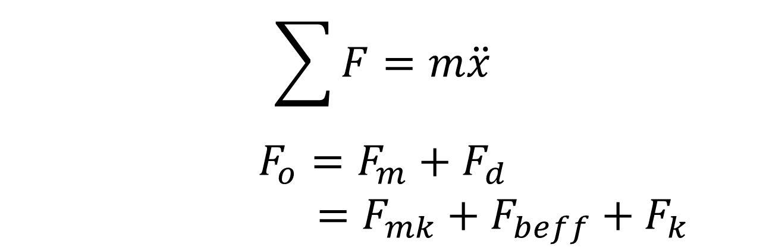
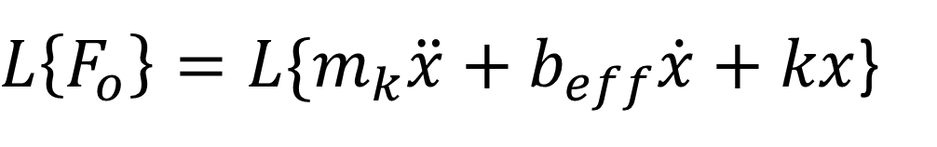
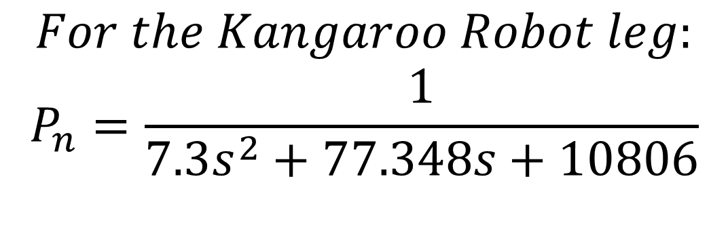


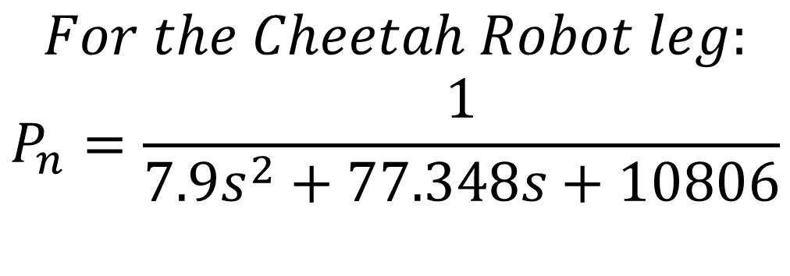
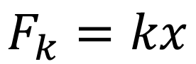

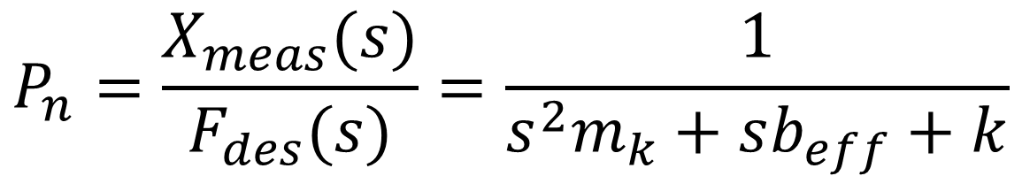
Mathematical Model Derivation
Motivation
Introduction
Problem Statement
The State of Art
Thesis Objective
Methodology
Results and Discussion
Conclusion
Future Recommendations
References
$$b_{eff}= b_{b}+b_{k}$$
$$F_{o}=m_{k}\ddot{x}+b_{eff}\dot{x}+kx$$
$$\sum{F}=m\ddot{x}$$
$$F_{o}=F_{m}+F_{d}$$
$=F_{mk}+F_{beff}+F_{k}$
$L\left\{F_{o}\right\}=L\{m_{k}\ddot{x}+b_{eff}\dot{x}+kx$}
$F_{o}\left(s\right)=X\left(s\right)[m_{k}s^{2}+b_{eff}s+k$]
$$P_{n}=\frac{X_{meas}(s)}{F_{des}(s)}=\frac{1}{s^{2}m_{k}+sb_{eff}+k}$$
$$F_{mk}=ma$$
$=m_{k}\ddot{x}$
$$For the Cheetah Robot leg:$$
$$P_{n}=\frac{1}{{7.9s}^{2}+77.348s+10806}$$
$$F_{beff}=b_{eff}v$$
$=b_{eff}\dot{x}$
$$For the Kangaroo Robot leg:$$
$$P_{n}=\frac{1}{{7.3s}^{2}+77.348s+10806}$$
$$F_{k}=kx$$
UT-SEA RF-SEA Model[12]

Slide 21
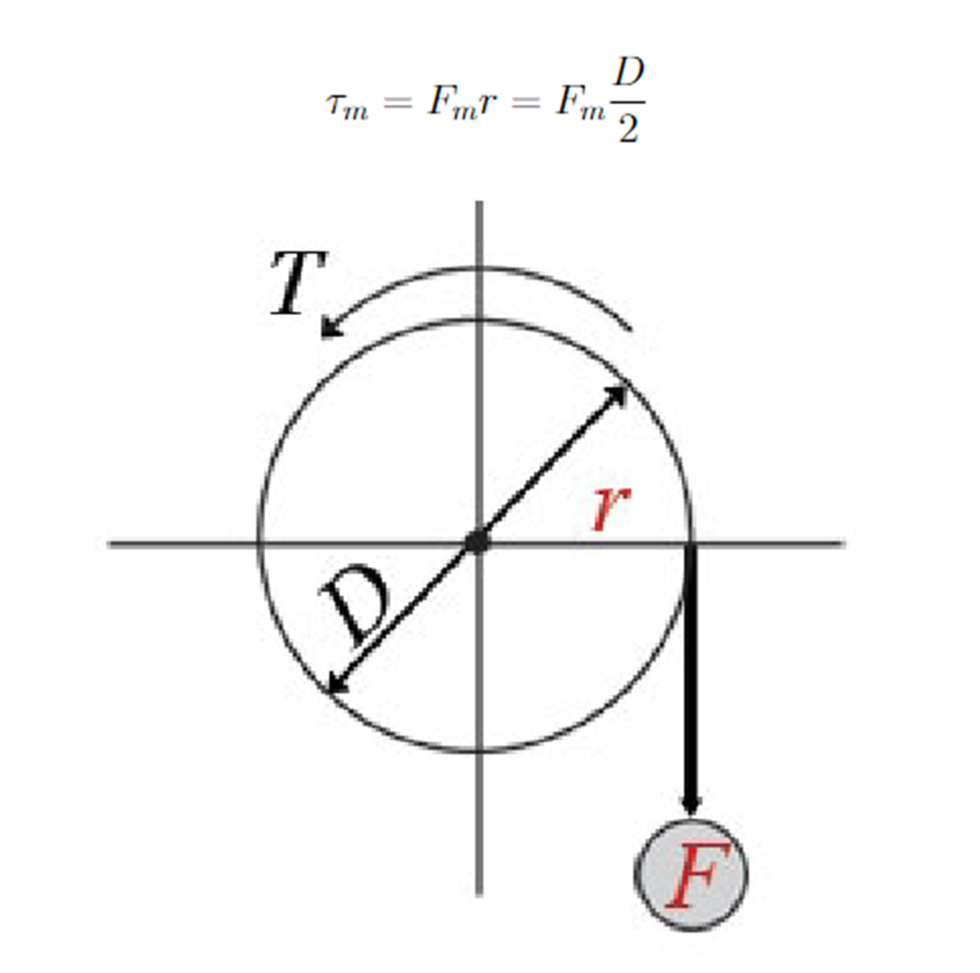
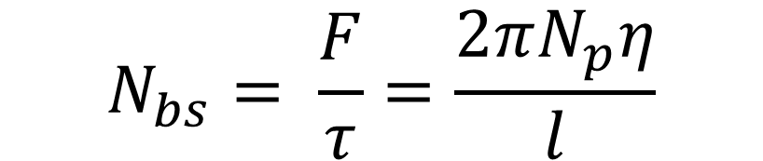
Force Control Loop Design 1
Motivation
Introduction
Problem Statement
The State of Art
Thesis Objective
Methodology
Results and Discussion
Conclusion
Future Recommendations
References
The goal of force control is to make measured actuator output force track the desired force profile using motor torque (τm) as the plant input and measured spring deflection (Xmeas) as the output.
The compensator consists of a feedback term. The feedback attempts to keep the difference between desired force (Fdes) or (Fm) and the measured spring force (Fkmeas) small. (Fdes) is calculated using (τdes) multiplied by the force amplification due to the speed reduction of the gearbox (Nbs).
Relation between motor’s force and torque[12]
$$N_{bs}= \frac{F}{τ}=\frac{2πN_{p}η}{l}$$

Slide 22
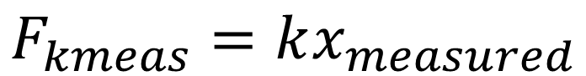
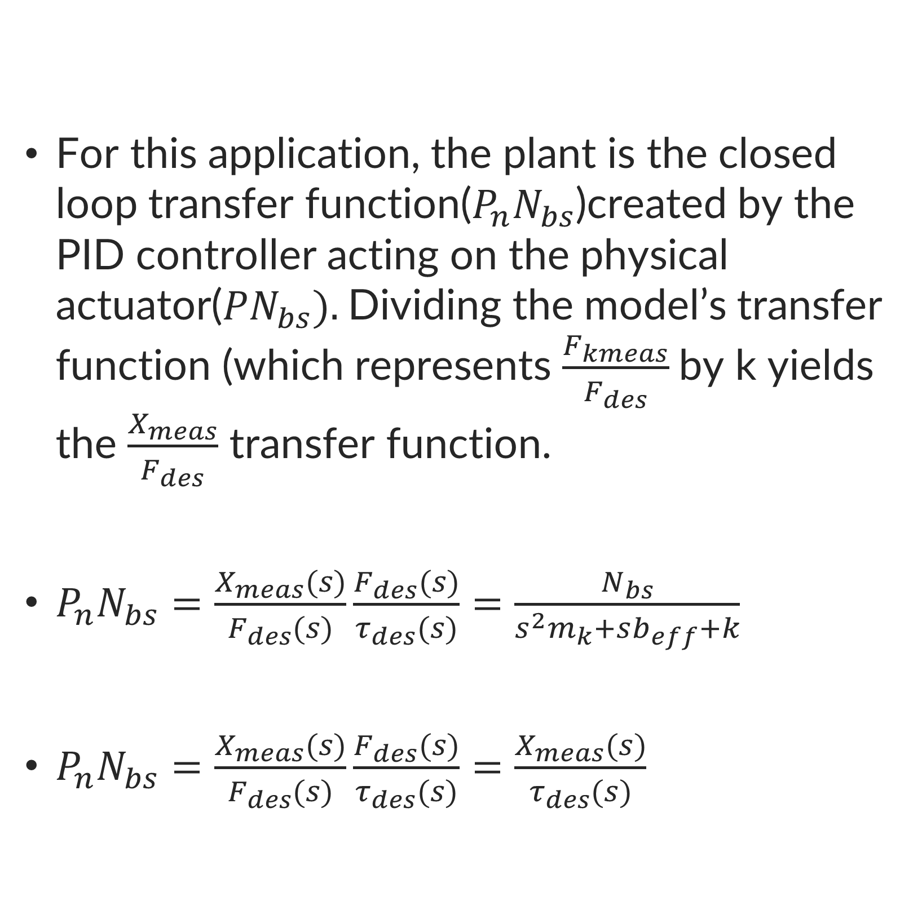
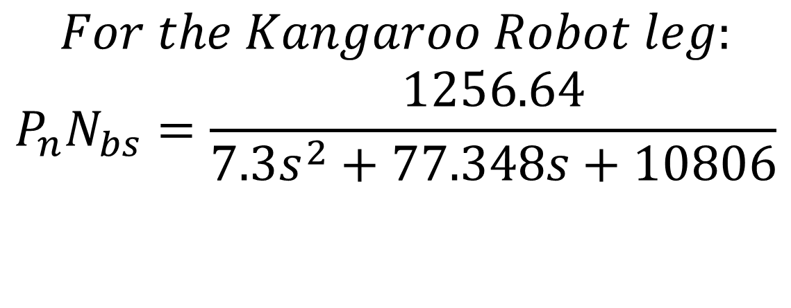
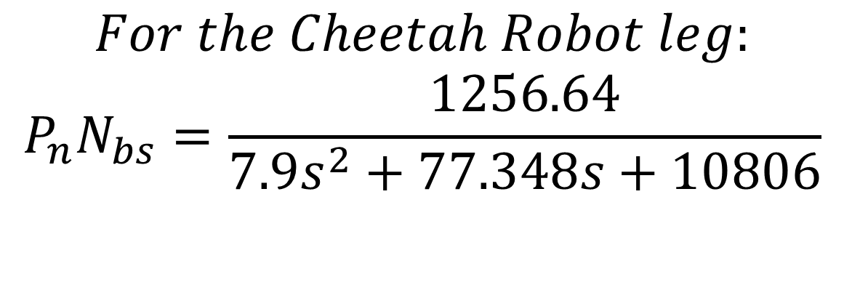
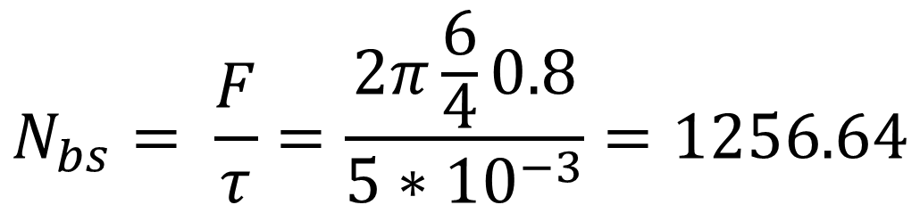
Force Control Loop Design 2
For this application, the plant is the closed loop transfer function($P_{n}N_{bs}$)created by the PID controller acting on the physical actuator(${PN}_{bs}).$Dividing the model’s transfer function (which represents $\frac{F_{kmeas}}{F_{des}}$by k yields the $\frac{X_{meas}}{F_{des}}$ transfer function.
$P_{n}N_{bs}=\frac{X_{meas}(s)}{F_{des}(s)}\frac{F_{des}(s)}{τ_{des}(s)}=\frac{N_{bs}}{s^{2}m_{k}+sb_{eff}+k}$
$P_{n}N_{bs}=\frac{X_{meas}(s)}{F_{des}(s)}\frac{F_{des}(s)}{τ_{des}(s)}=\frac{X_{meas}(s)}{τ_{des}(s)}$
Motivation
Introduction
Problem Statement
The State of Art
Thesis Objective
Methodology
Results and Discussion
Conclusion
Future Recommendations
References
$$F_{kmeas}=kx_{measured}$$
$$N_{bs}= \frac{F}{τ}=\frac{2π\frac{6}{4}0.8}{5∗{10}^{−3}}=1256.64$$
$$For the Cheetah Robot leg:$$
$$P_{n}N_{bs}=\frac{1256.64}{{7.9s}^{2}+77.348s+10806}$$
$$For the Kangaroo Robot leg:$$
$$P_{n}N_{bs}=\frac{1256.64}{{7.3s}^{2}+77.348s+10806}$$

Slide 23
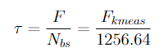
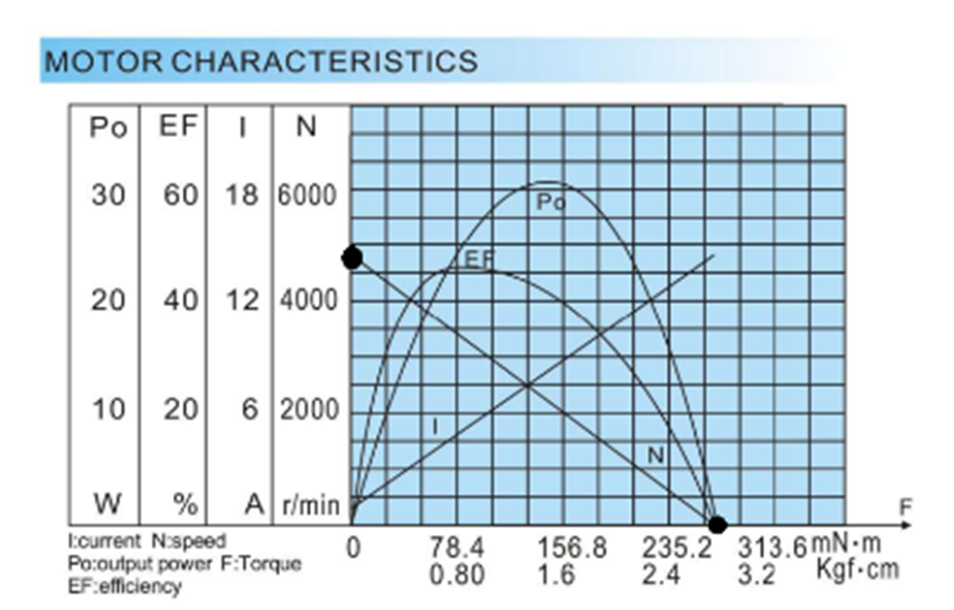
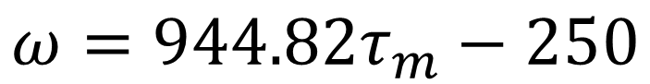
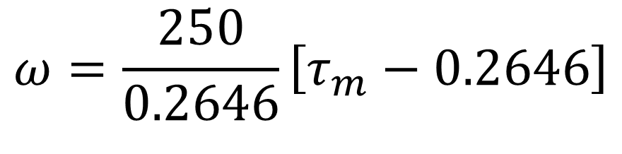
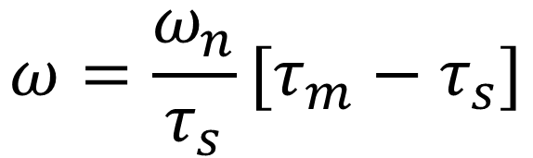
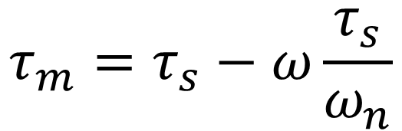
Motor RPM and Torque Relation
Motivation
Introduction
Problem Statement
The State of Art
Thesis Objective
Methodology
Results and Discussion
Conclusion
Future Recommendations
References
In order to relate the force control problem to motor motion, it is required to relate the motor force by the motor speed or rpm. This will be done by first converting the force to torque. This conversion is done by the ball screw reduction.
$$τ_{m}=τ_{s}−ω\frac{τ_{s}}{ω_{n}}$$
$$ω=\frac{ω_{n}}{τ_{s}}[τ_{m}−τ_{s}]$$
$$ω=\frac{250}{0.2646}\left[τ_{m}−0.2646\right]$$
$$ω=944.82τ_{m}−250$$
SG-20K Characteristics[16]

Slide 24
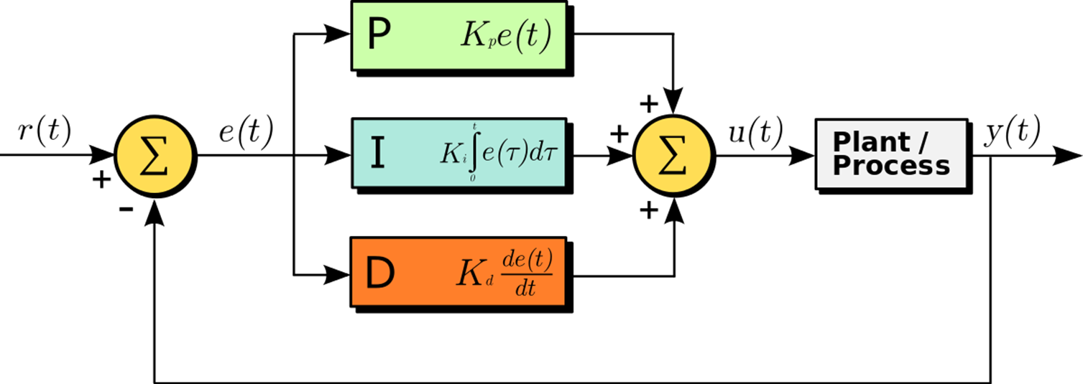
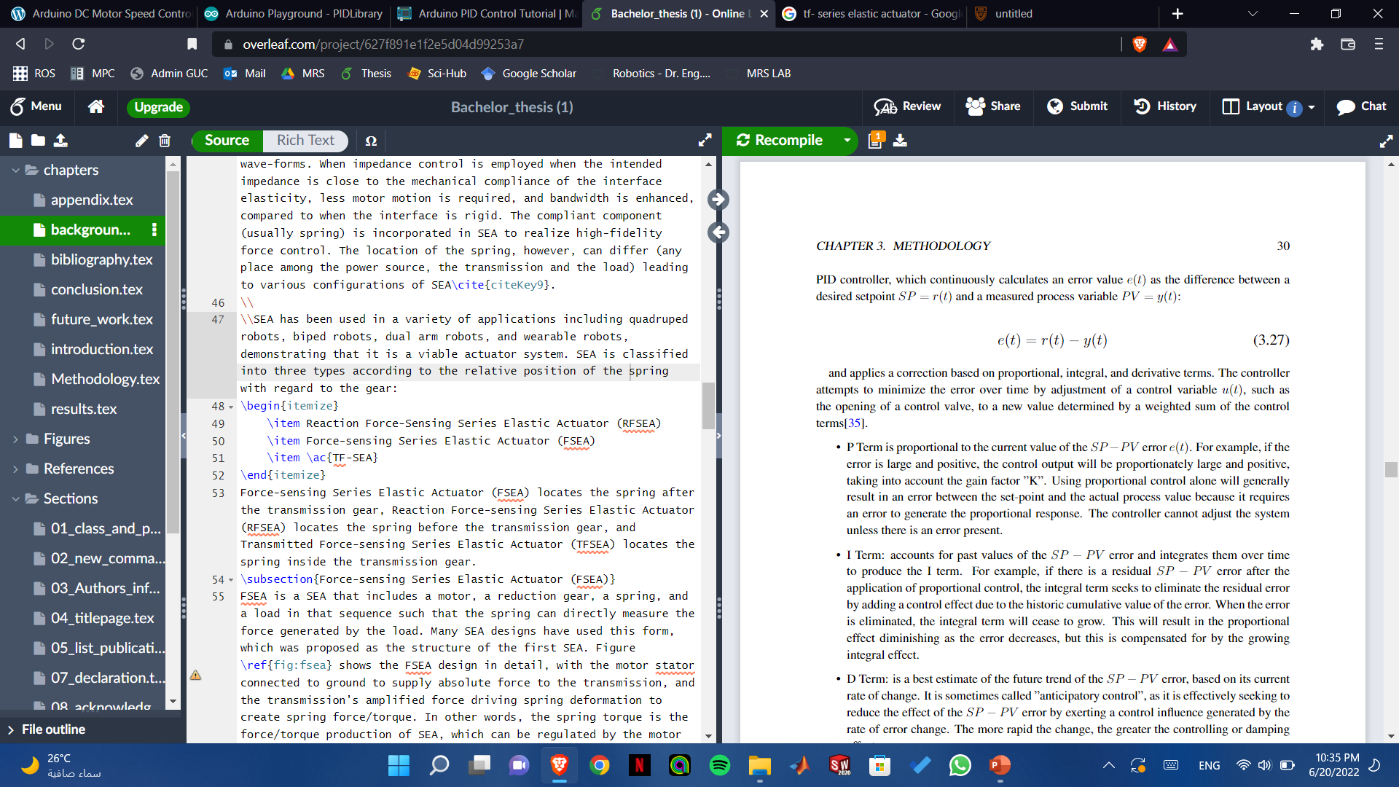
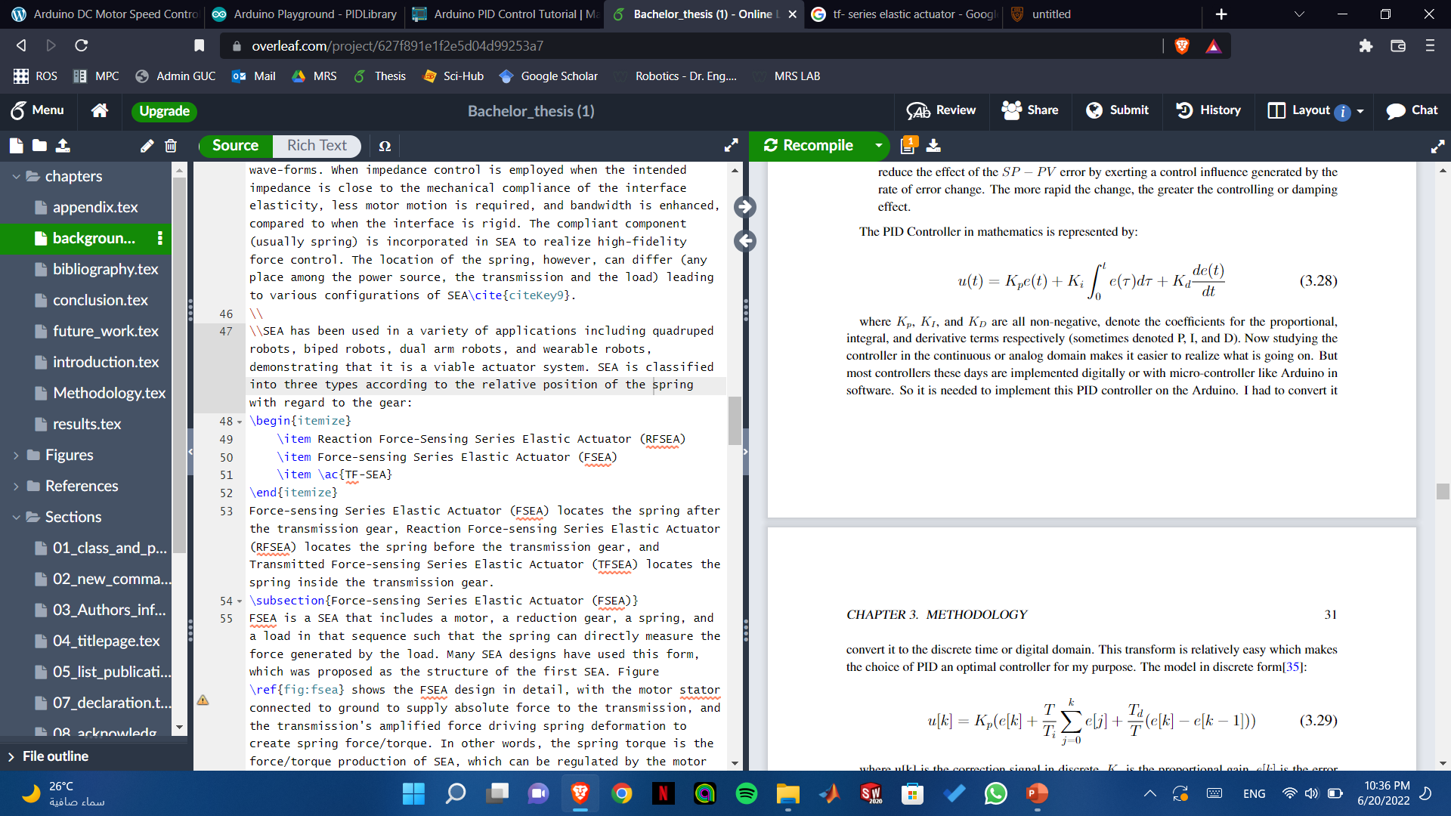
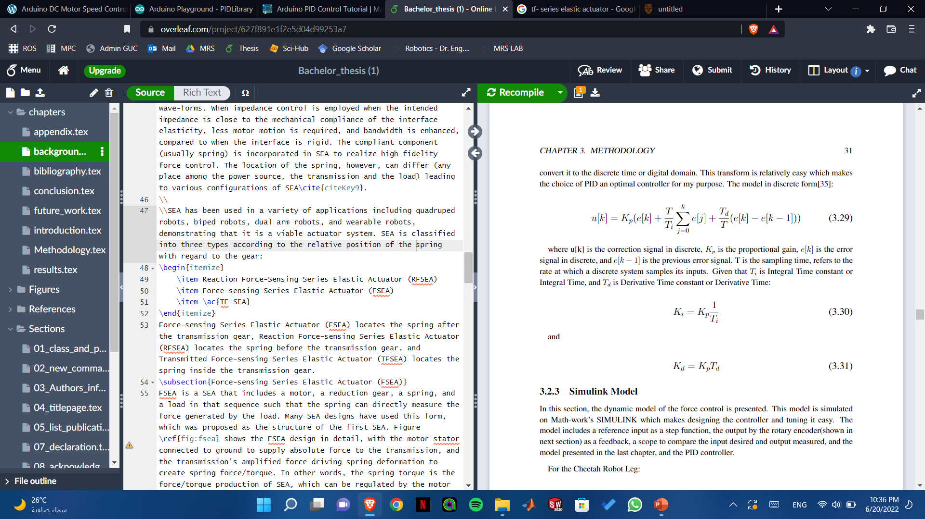
The Choice of PID
Motivation
Introduction
Problem Statement
The State of Art
Thesis Objective
Methodology
Results and Discussion
Conclusion
Future Recommendations
References
A proportional–integral–derivative controller (PID controller or three-term controller) is a control loop mechanism employing feedback that is widely used in industrial control systems and a variety of other applications requiring continuously modulated control.
A PID controller continuously calculates an error value e(t) as the difference between the desired setpoint (SP) and a measured process variable (PV) and applies a correction based on proportional, integral, and derivative terms (denoted P, I, and D respectively), hence the name.
PID Feedback Diagram[17]

Slide 25
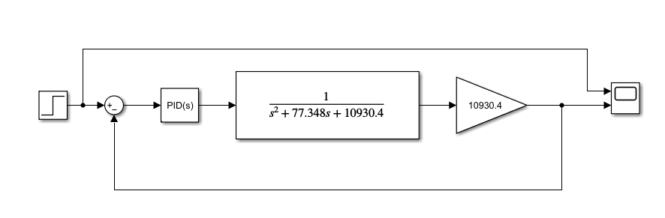
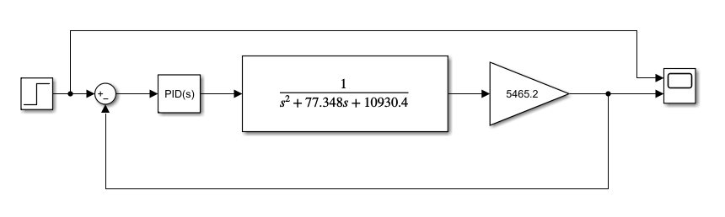
SIMULINK Models
Motivation
Introduction
Problem Statement
The State of Art
Thesis Objective
Methodology
Results and Discussion
Conclusion
Future Recommendations
References
Cheetah:
Kangaroo:

Slide 26
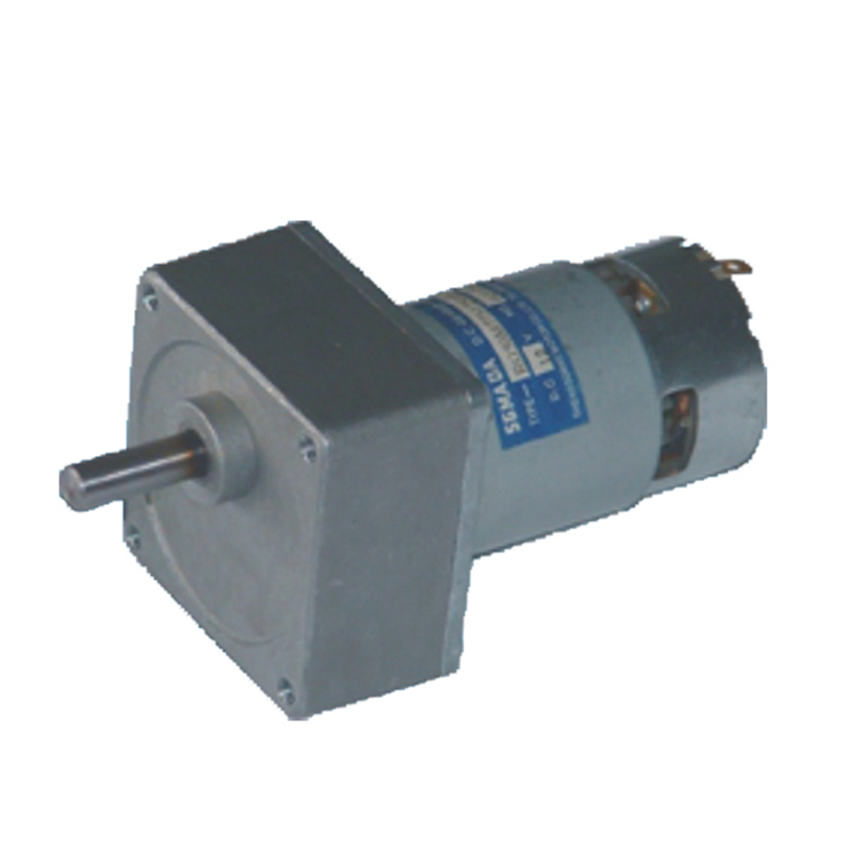

Force Control Hardware
Motivation
Introduction
Problem Statement
The State of Art
Thesis Objective
Methodology
Results and Discussion
Conclusion
Future Recommendations
References
Actuator: The motor used is the SG775125000-20K DC Geared Motor
Torque: 1.03 N.m
Speed: 250 rpm
Motor Driver: The motor driver used was Cytron 10Amp 7V-30V DC Motor Driver. • Bi-directional control for DC motor. • Support motor voltage ranges from 7V to 30V. • Maximum current up to 10A continuous and 30A peak (10 seconds). 3.3V and 5V logic level input.
SG-20K Motor[16]
Cytron 10Amp 7V-30V DC Motor Driver[18]

Slide 27

Force Control Hardware
Motivation
Introduction
Problem Statement
The State of Art
Thesis Objective
Methodology
Results and Discussion
Conclusion
Future Recommendations
References
Microcontroller: The microcontroller used is Arduino UNO REV3. The Arduino UNO is an open-source microcontroller board based on the Microchip ATmega328P microcontroller and developed by Arduino.cc.
Microcontroller: Microchip ATmega328P[7] • Operating Voltage: 5 Volts • Input Voltage: 7 to 20 Volts • Digital I/O Pins: 14 (of which 6 can provide PWM output) • PWM Pins: 6 (Pin numbers 3, 5, 6, 9, 10 and 11) • UART: 1 • I2C: 1 • SPI: 1 • Analog Input Pins: 6 • DC Current per I/O Pin: 20 mA • DC Current for 3.3V Pin: 50 mA
Arduino UNO REV3 Pinout[19]

Slide 28


Force Control Hardware
Motivation
Introduction
Problem Statement
The State of Art
Thesis Objective
Methodology
Results and Discussion
Conclusion
Future Recommendations
References
Power Supply: 12 Volts, 10 Ampere power supply was used according to the motor’s requirement.
Rotary Encoder: A rotary encoder is a type of position sensor which is used for determining the angular position of a rotating shaft.

Slide 29


Pulley System
Motivation
Introduction
Problem Statement
The State of Art
Thesis Objective
Methodology
Results and Discussion
Conclusion
Future Recommendations
References
Belt: GT2 Timing Belt was used, which has a 2mm pitch and a 6mm width with a 49.4 cm length.
Pulley:
For the Kangaroo robot, every 12 ticks represent 1.8cm deformation. So whenever the encoder outputs ticks, a spring deformation by this amount is shown. deformation = 1.8ticks/12
For the Cheetah robot, every 11 ticks represent 1.8cm deformation. So whenever the encoder outputs ticks, a spring deformation by this amount shown: deformation = 1.8ticks/11
Pulley components[21]
GT2 49.4 cm length Timing Belt[21]

Slide 30



Slide 31

Circuit
Motivation
Introduction
Problem Statement
The State of Art
Thesis Objective
Methodology
Results and Discussion
Conclusion
Future Recommendations
References

Slide 32




Cheetah Robot Simulation
Motivation
Introduction
Problem Statement
The State of Art
Thesis Objective
Methodology
Results and Discussion
⬤⭕⭕
Conclusion
Future Recommendations
References

Slide 33


Tuning Choice
Motivation
Introduction
Problem Statement
The State of Art
Thesis Objective
Methodology
Results and Discussion
⬤⬤⭕
Conclusion
Future Recommendations
References
When tuning the controller, 2 choices were given. Either choosing a faster response time or a more robust transient response. A faster Response means more overshoot, while a slower response means zero overshoot. A more robust transient response means a slower response. When the controller is tested on hardware, a faster response was more favorable.
Therefore the controllers were designed based on a faster response. The figure on the right shows a slower step response which has degraded most of the requirements but decreased the overshoot of the closed-loop response. The table compares the characteristics of both respsonses.

Slide 34




Kangaroo Robot Simulation
Motivation
Introduction
Problem Statement
The State of Art
Thesis Objective
Methodology
Results and Discussion
⬤⬤⬤
Conclusion
Future Recommendations
References

Slide 35
Conclusion
Motivation
Introduction
Problem Statement
The State of Art
Thesis Objective
Methodology
Results and Discussion
Conclusion
Future Recommendations
References
Series Elastic Actuators provide many benefits in force control of robots in unconstrained environments. These benefits include high force fidelity, extremely low impedance, low friction, and good force control bandwidth. Series Elastic Actuators employs a novel mechanical de- sign architecture that goes against the common machine design principle of “stiffer is better”.
A compliant element is placed between the gear train and the driven load to intentionally reduce the stiffness of the actuator. These characteristics are desirable in many applications including legged robots, exoskeletons for human performance amplification, robotic arms, haptic interfaces, and adaptive suspensions.

Slide 36
Future Recommendations
Motivation
Introduction
Problem Statement
The State of Art
Thesis Objective
Methodology
Results and Discussion
Conclusion
Future Recommendations
References
The Bachelor’s project work throughout the semester was to design and implement a control system on a Series Elastic Actuator Robotic Legs, Cheetah, and Kangaroo. Future Work that can be performed : • Performing a design, model, and control for a Series Elastic Actuated Running and walking on two-leg mechanisms. • Perform high-level control techniques on legged robotics SEA-based like Model Predictive Control(MPC), Adaptive Control, Fuzzy Logic Control, or Linear Quadratic Regulator Control(LQR). • Implement the Series Elastic Actuator using the F-SEA model and implement it on Humanoid Legs.
Implement a dynamic stability criterion for walking and balancing using control architectures using an IMU.

Slide 37
References
Motivation
Introduction
Problem Statement
The State of Art
Thesis Objective
Methodology
Results and Discussion
Conclusion
Future Recommendations
References
⬤⭕⭕
https://commons.wikimedia.org/wiki/File:ATHLETE_robot_climbing_a_hill.jpg
https://edition.cnn.com/videos/us/2021/02/25/robot-dog-paintball-gun-moos-pkg-vpx.cnn
https://hackaday.com/2015/12/03/an-introduction-to-series-elastic-actuators-for-a-robot/
https://www.google.com/search?q=series+elastic+actuator+gif&tbm=isch&ved=2ahUKEwiEhaLW0bz4AhUONBoKHd0_CLgQ2-cCegQIABAA&oq=series+elastic+actuator+gif&gs_lcp=CgNpbWcQA1AAWNsDYM4JaABwAHgAgAGxAYgBqAOSAQMwLjOYAQCgAQGqAQtnd3Mtd2l6LWltZ8ABAQ&sclient=img&ei=hLmwYoSzKI7oaN3_oMAL&bih=718&biw=1536&safe=active#imgrc=6xkAbwtXeoybrM, 17
https://www.therobotreport.com/top-5-countries-using-industrial-robots-2018/
https://www.osha.gov/otm/section-4-safety-hazards/chapter-4
https://giphy.com/explore/cobot
https://insights.tuv.com/hs-fs/hubfs/Images/P04/lady%20operator%20with%20cobots.jpg?width=607&height=351&name=lady%20operator%20with%20cobots.jpg

Slide 38
Motivation
Introduction
Problem Statement
The State of Art
Thesis Objective
Methodology
Results and Discussion
Conclusion
Future Recommendations
References
⬤⬤⭕
9. https://www.mdpi.com/1424-8220/19/24/5351/htm
10. https://hackaday.com/2015/12/03/an-introduction-to-series-elastic-actuators-for-a-robot/
11. https://hackaday.com/2013/12/03/compliant-robot-gripper-wont-scramble-your-eggs/
12. https://www.frontiersin.org/articles/10.3389/fnbot.2019.00017/full
13. Robinson, D. W., Pratt, J. E., Paluska, D. J., & Pratt, G. A. (1999, September). Series elastic actuator development for a biomimetic walking robot. In 1999 IEEE/ASME International Conference on Advanced Intelligent Mechatronics (Cat. No. 99TH8399) (pp. 561-568). IEEE.
14. Paine, N., Oh, S., & Sentis, L. (2013). Design and control considerations for high-performance series elastic actuators. IEEE/ASME Transactions on Mechatronics, 19(3), 1080-1091.
15. Wyeth, G. (2008, May). Demonstrating the safety and performance of a velocity sourced series elastic actuator. In 2008 IEEE International Conference on Robotics and Automation (pp. 3642-3647). IEEE.
16. https://yaoota.com/en-eg/product/dc-geared-motor-sg775125000-60k-20-watt-94rmin-279-nm-dcsg77-price-from-ram-e-shop-egypt

Slide 39
Motivation
Introduction
Problem Statement
The State of Art
Thesis Objective
Methodology
Results and Discussion
Conclusion
Future Recommendations
References
⬤⬤⬤
17. https://en.wikipedia.org/wiki/PID_controller
18. https://ram-e-shop.com/product/cytron-10amp-5v-30v-dc-motor-driver-2-channels-mdd10a/
19. https://linuxhint.com/arduino-uno-pinout-guide/
20. https://howtomechatronics.com/tutorials/arduino/rotary-encoder-works-use-arduino/
21. https://www.rs-online.vn/p/htd-timing-belt-450-5m-15/1755214/

